Slide 1
TANGO-Grafana: an online diagnostic tool to assist in the analysis of interconnected problems difficult to debug in the context of the Square Kilometre Array (SKA) telescope project
Matteo Di Carlo (INAF-OAAB)
P. Harding, G. Le Roux, M. Dolci

Slide 2






SKAMPI
The🌍 SKA MVP Prototype Integration (SKAMPI): set of software artefacts, the corresponding repository and continuous integration facilities for the development, testing, and integration of the SKA prototype software systems
Tango-controls

Slide 3
capSub1ImgCont
adminMode = ONLINE
healthStatus = OK
state = ON
obsState = SCANNING
obsMode = IMG-CONTINUUM
capSub.m.ImgCont
adminMode = OFFLINE
healthStatus = OK
obsState = IDLE
state=ON
obsMode = IDLE
SKA-MID Subarrays & Capabilities
capSub16ImgCont
adminMode = OFFLINE
healthStatus = OK
state = ON
obsState = IDLE
obsMode = IDLE
TM Central Node
state = ON
healthStatus = OK
adminMode = ENABLED
Many different active components coordinating each other with the help of the TANGO-controls framework
SDP_MID EltMaster
adminMode = ONLINE
healthStatus = OK
state=ON
capSub1ImgTranSearch
adminMode = OFFLINE
healthStatus = OK
adminMode = NOT_FITTED
obsState = IDLE
obsMode = IDLE
capSub.m.ImgTranSrch
adminMode = OFFLINE
subarray1
adminMode = ONLINE
healthStatus = OK
state=ON
obsState(s) ? = SCANNING
obsMode = IMG-CONTINUUM
capSub1ImgSpctlLine
adminMode = OFFLINE
healthStatus = OK
adminMode = NOT_FITTED
obsState = IDLE
obsMode = IDLE
capSub16ImgTranSearch
adminMode = OFFLINE
capSub.m.ImgSpctlLn
adminMode = OFFLINE
capSub16ImgSpctlLine
adminMode = OFFLINE
capSub1ProcessPssBeams
adminMode = OFFLINE
healthStatus = OK
adminMode = NOT_FITTED
obsState = IDLE
obsMode = IDLE
capSub.m.ProcessPssBeams
adminMode = OFFLINE
TM Subarray1
state = ON
healthStatus = OK
adminMode = ENABLED
obsState ? = SCANNING
obsMode (per capability)
capSub1ProcessPstBeams
adminMode = OFFLINE
healthStatus = OK
adminMode = NOT_FITTED
obsState = IDLE
obsMode = IDLE
capSub.m.ProcessVlbiBeams
adminMode = OFFLINE
healthStatus = OK
obsState = IDLE
state=ON
obsMode = IDLE
capSub16ProcessPssBeams
adminMode = OFFLINE
TM Subarray.m.
state = ON
healthStatus
adminMode
obsState
obsMode
subarray.m.
adminMode = OFFLINE
healthStatus = OK
state=ON
obsState(s) ? = IDLE
state=ON
capSub1ProcessVlbiBeams
adminMode = OFFLINE
healthStatus = OK
state = ON
obsState = IDLE
obsMode = IDLE
capSub.m.ProcessPstBeams
adminMode = OFFLINE
capSub16ProcessPstBeams
adminMode = OFFLINE
TM SubarrayN(16+)
adminMode = ONLINE
state = ON
healthStatus = OK
obsState = CONFIGURING
obsMode = VLBI
capSub16ProcessVlbiBeams
adminMode = ONLINE
healthStatus = OK
state = ON
obsState = CONFIGURING
obsMode = VLBI
subarrayN(16+)
adminMode = ONLINE
healthStatus = OK
state=ON
obsState(s) ? = CONFIGURING
obsMopde = VLBI
capBand1
adminMode = OFFLINE
healthStatus = OK
obsState = IDLE
state=ON
CSP_MID EltMaster
state = ON
healthStatus = OK
adminMode = ENABLED
capSub1Imaging
adminMode = ONLINE
healthStatus = OK
state = ON
obsState = SCANNING
obsMode = IMG-CONTINUUM
nrOfBaselines = 512
capSub.m.Imaging
adminMode = OFFLINE
healthStatus = OK
state = ON
obsState = IDLE
obsMode = IDLE
nrOfBaselines = 0
capBand2
adminMode = ONLINE
healthStatus = OK
obsState = SCANNING
state=ON
D000N EltMaster
state = ON
healthStatus = OK
adminMode = ENABLED
selectedBand = BAND 2
capSub16Imaging
adminMode = OFFLINE
healthStatus = OK
state = ON
obsState = IDLE
obsMode = IDLE
nrOfBaselines = 0
D0001 EltMaster
state = ON
healthStatus = OK
adminMode = ENABLED
selectedBand = BAND 2
subarray1
adminMode = ONLINE
healthStatus = OK
state=ON
obsState(s) ? = SCANNING
capSub1PssBeams
adminMode = OFFLINE
healthStatus = OK
state = ON
obsState = IDLE
obsMode = PULSAR-SEARCH nrOfPssBeams = 4
capBand3
adminMode = OFFLINE
healthStatus = OK
obsState = IDLE
state=ON
capSub.m.PssBeams
adminMode = OFFLINE
healthStatus = OK
state = ON
obsState = IDLE
obsMode = IDLE
nrOfPssBeamss = 0
capSub16PssBeams
adminMode = OFFLINE
healthStatus = OK
state = ON
obsState = IDLE
obsMode = IDLE
nrOfPstBeams = 0
subarray.m.
adminMode = OFFLINE
healthStatus = OK
state=ON
obsState(s) ? = IDLE
state=ON
capBand4
adminMode = OFFLINE
healthStatus = FAIL
obsState = IDLE
state=ON
capSub1PstBeams
adminMode = NOT_FITTED
healthStatus = OK
state = ON
obsState = IDLE
obsMode = IDLE nrOfPstBeams = 0
capSub.m.PstBeams
adminMode = NOT_FITTED
healthStatus = OK
state = ON
obsState = IDLE
obsMode = IDLE nrOfPstBeams = 0
capSub16PstBeams
adminMode = NOT_FITTED
healthStatus = OK
state = ON
obsState = IDLE
obsMode = IDLE nrOfPstBeams = 0
subarray16
sadminMode = ONLINE
healthStatus = OK
obsState(s) ? = CONFIGURING
state=ON
capBand5
adminMode = OFFLINE
healthStatus = OK
obsState = IDLE
state=ON
capSub1VlbiBeams
adminMode = OFFLINE
healthStatus = OK
state = ON
obsState = IDLE
obsMode = IDLE
nrOfVlbiBeams = 0
capSub.m.VlbiBeams
adminMode = OFFLINE
healthStatus = OK
state = ON
obsState = IDLE
obsMode = IDLE
nrOfVlbiBeams = 0
capSub16VlbiBeams
adminMode = ONLINE
healthStatus = OK
state = ON
obsState = CONFIGURING
obsMode = IDLE
nrOfVlbiBeams = 4

Slide 4
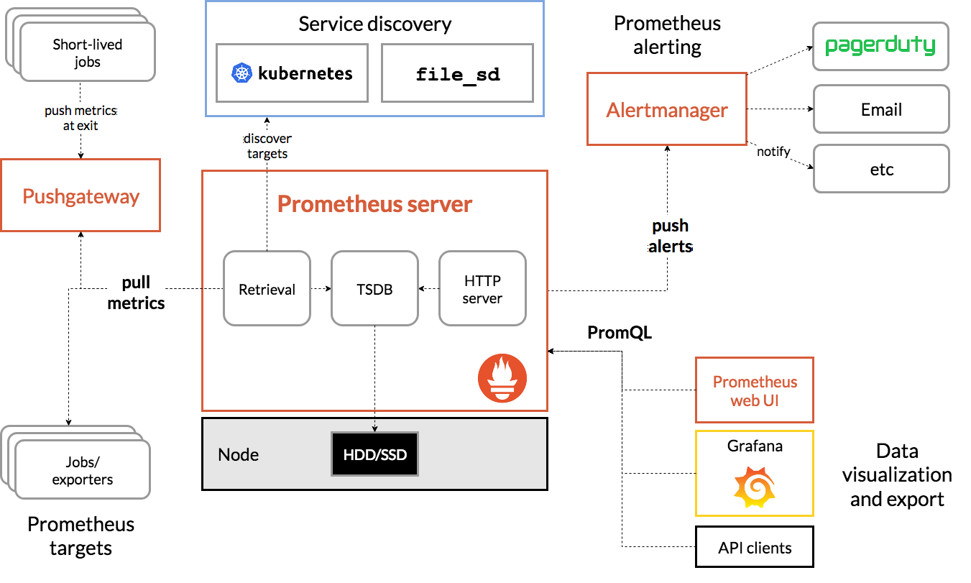
Prometheus as monitoring solution

Slide 5
Prometheus exporter
It is an http server which answer to requests with time series text/information
Every time series is uniquely identified by:
its metric name and
optional key-value pairs called labels.
<metric name>{<label name>=<label value>, ...}
It must have all the information related to the “instrument”
Development information:
https://prometheus.io/docs/practices/instrumentation/
Python client library for development
https://github.com/prometheus/client_python
4 types of metrics:
Counter: cumulative metric
Gauge: single numerical value that can arbitrarily go up and down
Histogram: samples observations (usually things like request durations or response sizes) and counts them in configurable buckets
Summary: samples observations (similar to a histogram)

Slide 6
Grafana
Engine for displaying data on web coming from many data sources
Working with grafana means to create dashboards which allows to understand something
Plugin architecture where a plugin can be:
A panel
A data source
An app (combination of data source and panels for a specific purpose)

Slide 7
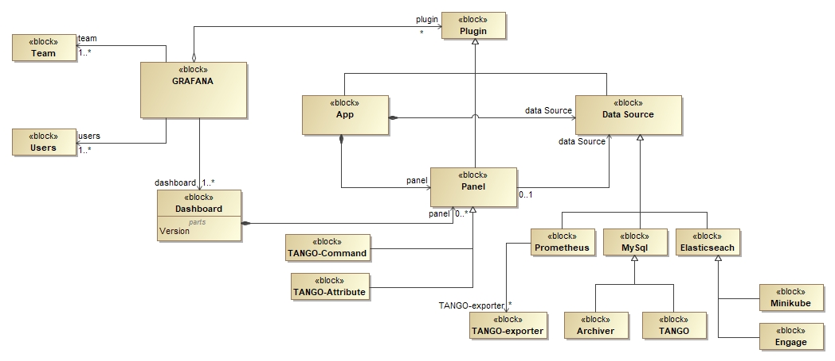
TANGO-Grafana: PROMETHEUS + GRAFANA + TANGO-controls

Slide 8
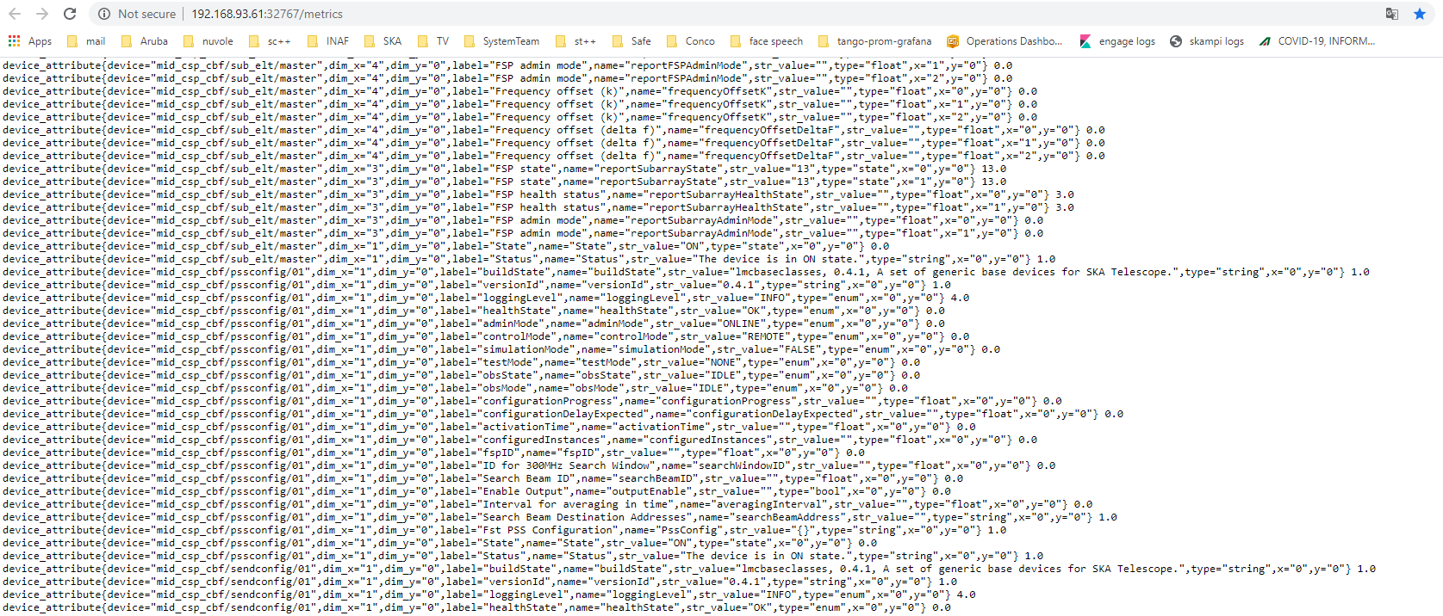
TANGO-Exporter
Read all the attributes from a TANGO control system
Timeout set at 10ms
device_attribute{
device="mid_csp_cbf/pssconfig/01",
dim_x="1",dim_y="0",
label="obsState",
name="obsState",
str_value="IDLE",
type="enum",
x="0",y="0"
} 0.0

Slide 9
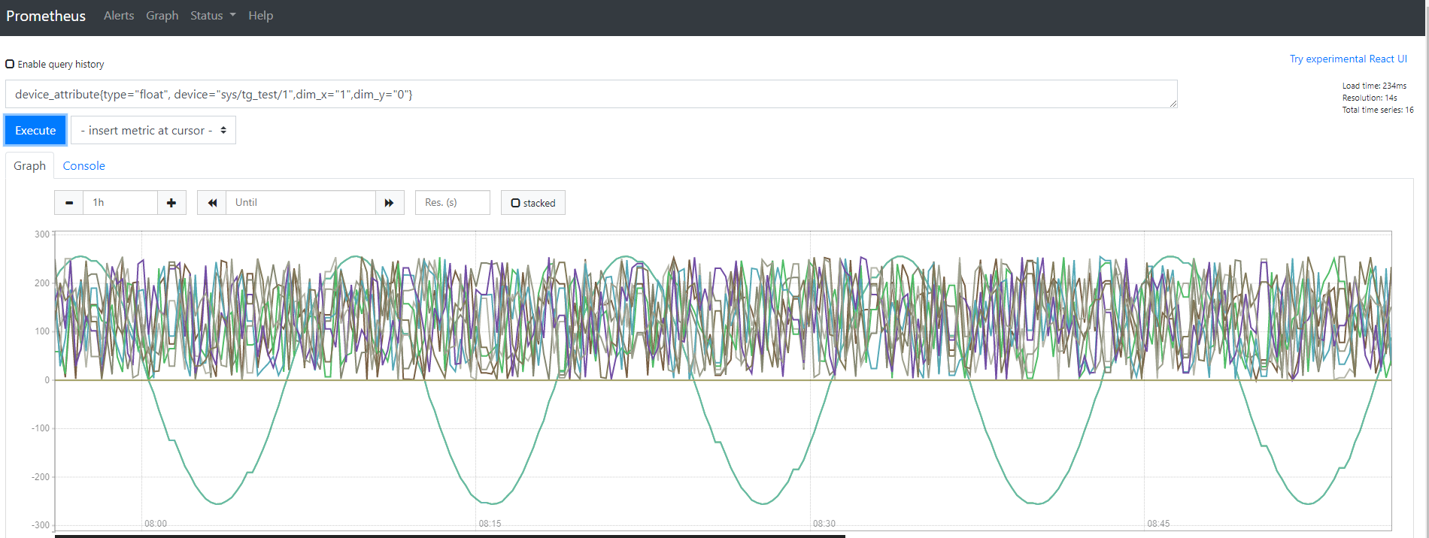
Prometheus graph engine

Slide 10
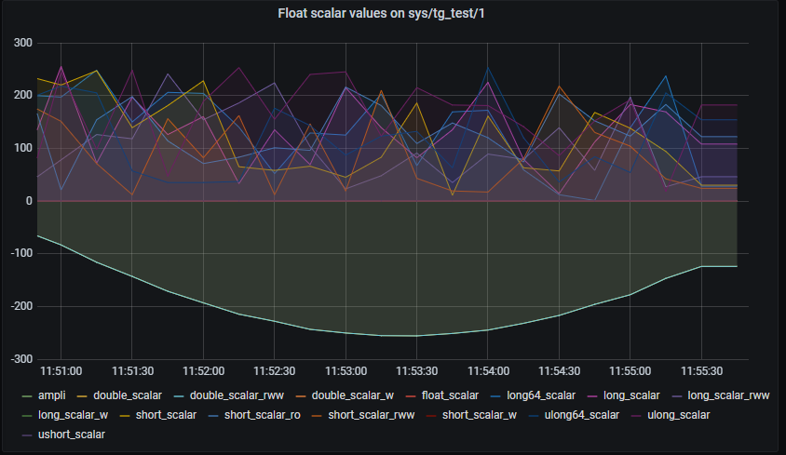
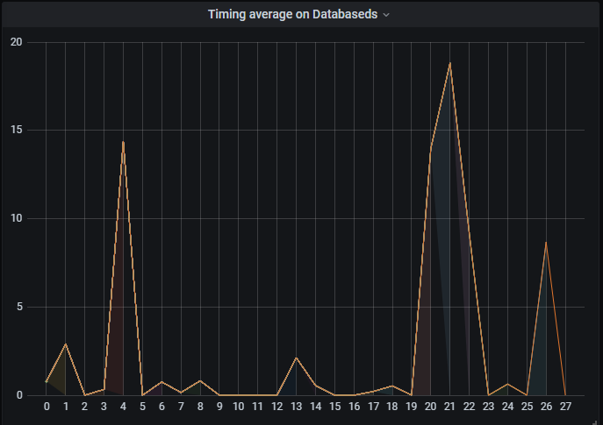
device_attribute{device="sys/tg_test/1",dim_x="1",dim_y="0", type="float"}
Grafana graph panel
device_attribute{device="sys/database/2",name="Timing_average"}

Slide 11
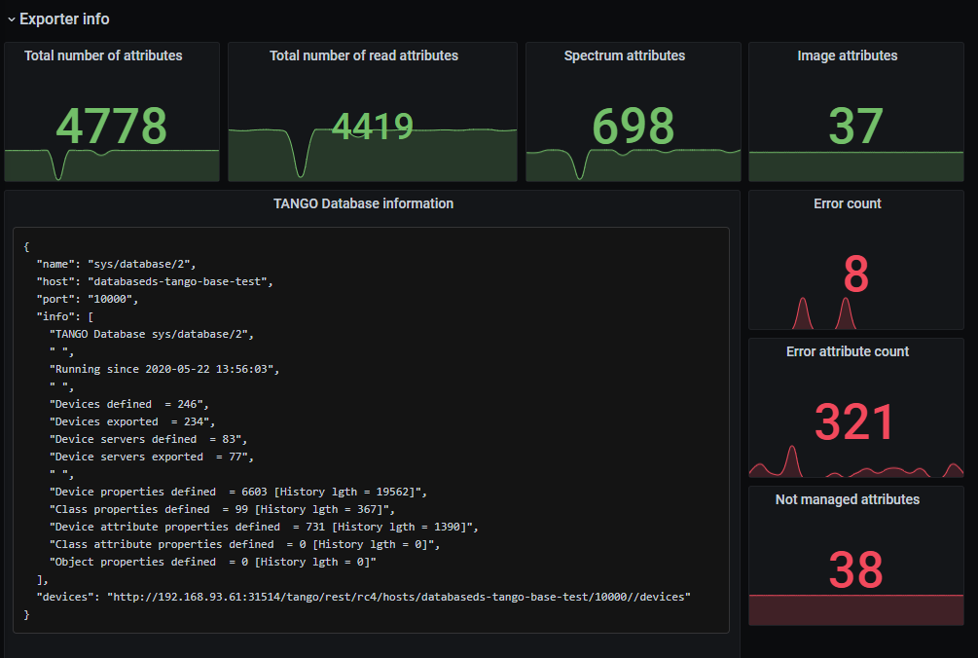
sum(attribute_count)
sum(spectrum_attribute_count)
Using the TANGO-rest
sum(attribute_read_count)
sum(image_attribute_count)
sum(error_count)
sum(error_attr_count)
sum(not_managed_attribute_count)
http get http://tango.rest.mid.integration.engageska-portugal.pt/tango/rest/rc4/hosts/databaseds-tango-base-test/10000/

Slide 12
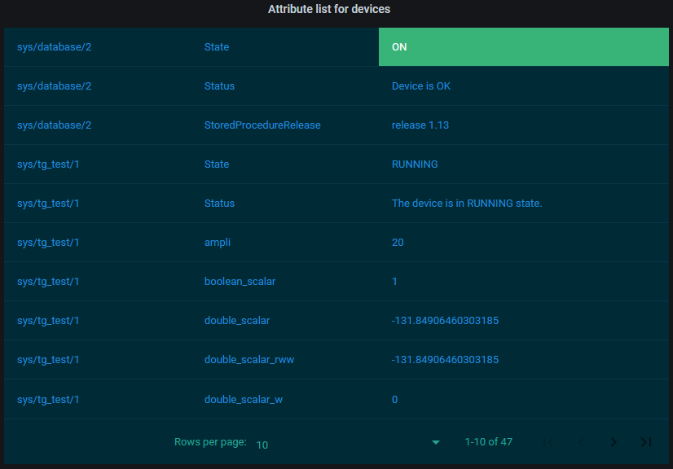
TANGO-Attribute: displaying strings
In prometheus and grafana, everything is a number.
In order to display strings, we need a new plugin:
Show attributes in a table form (label value in case of state/string/enum)
device_attribute{device=~"$devices"}

Slide 13
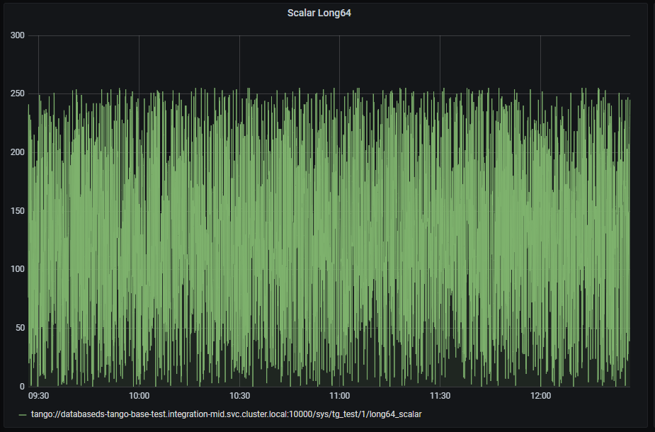
TANGO-Archiver data source
SELECT data_time AS "time", att_name, value_r
FROM att_scalar_devlong64_rw INNER JOIN att_conf ON att_conf.att_conf_id = att_scalar_devlong64_rw.att_conf_id
WHERE $__timeFilter(data_time)
ORDER BY data_time

Slide 14
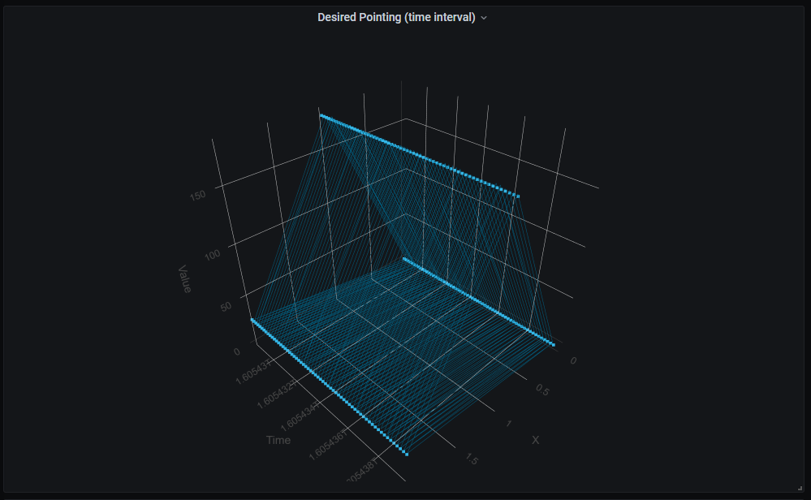
TANGO-Archiver data source and Plotly
SELECT
data_time as time_sec,
att_conf.name,
idx,
value_r as value
FROM att_array_devdouble_rw INNER JOIN att_conf ON att_conf.att_conf_id = att_array_devdouble_rw.att_conf_id
WHERE att_conf.att_name = 'tango://databaseds-tango-base-test.integration-mid.svc.cluster.local:10000/mid_d0001/elt/master/desiredpointing'
AND $__timeFilter(data_time)
ORDER BY data_time desc

Slide 15
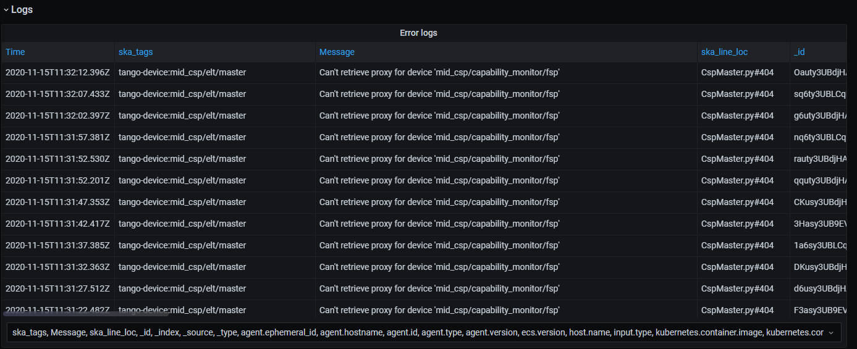
Elasticsearch data source
ska_severity: ERROR

Slide 16
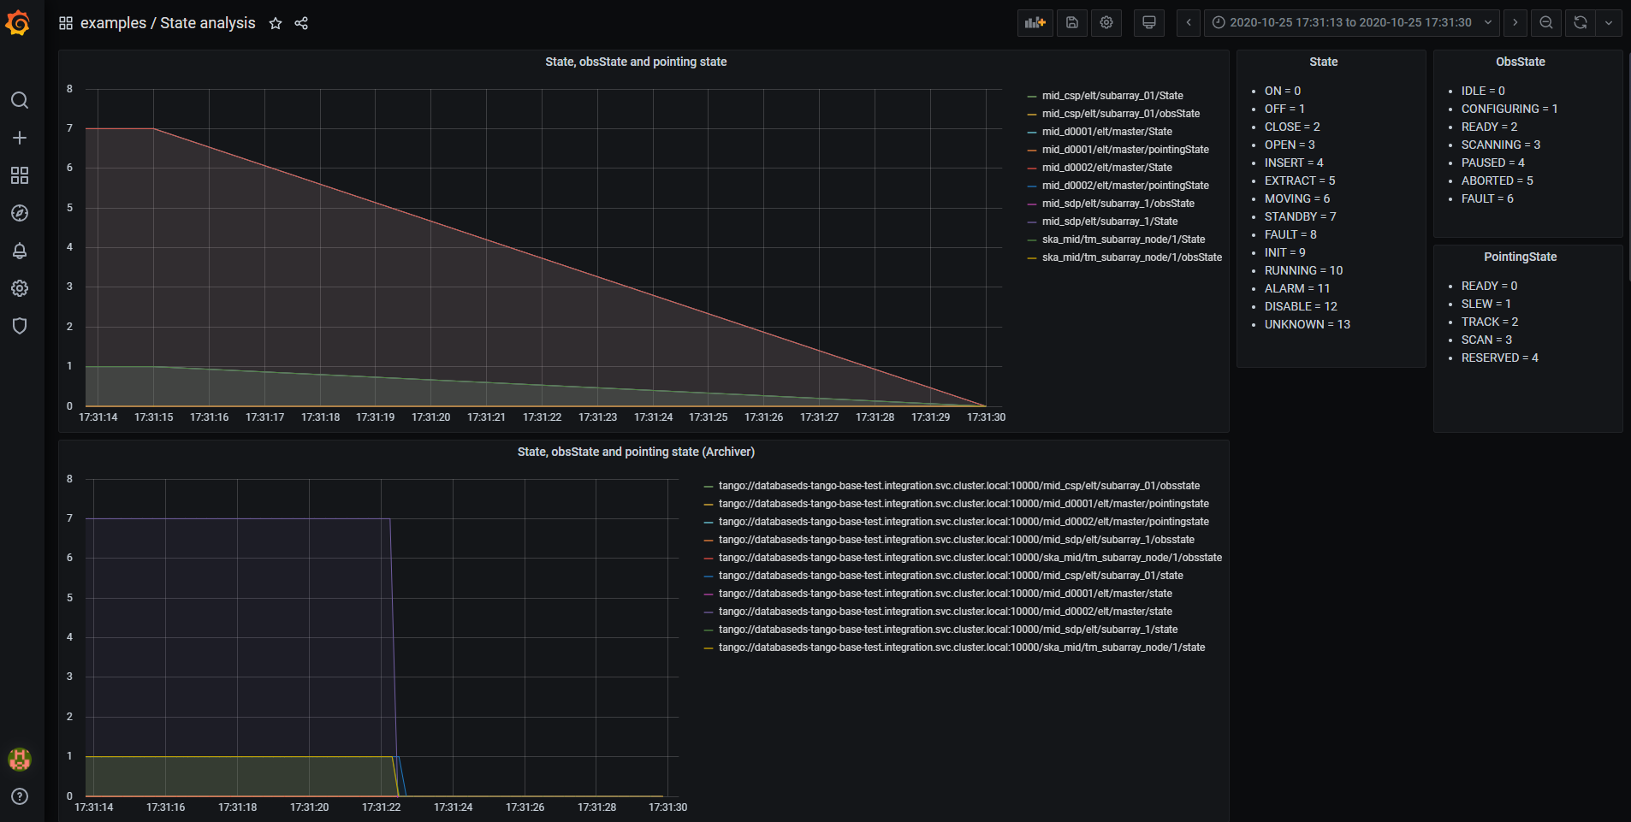
Many datasources one dashboard

Slide 17
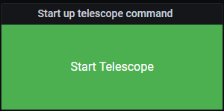
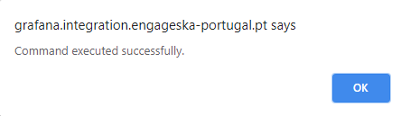
TANGO-Command
CORS problems
Proxy server to authentication and call to the TangoGQL backend
Getting the parameter for the call is tricky
Click

Slide 18
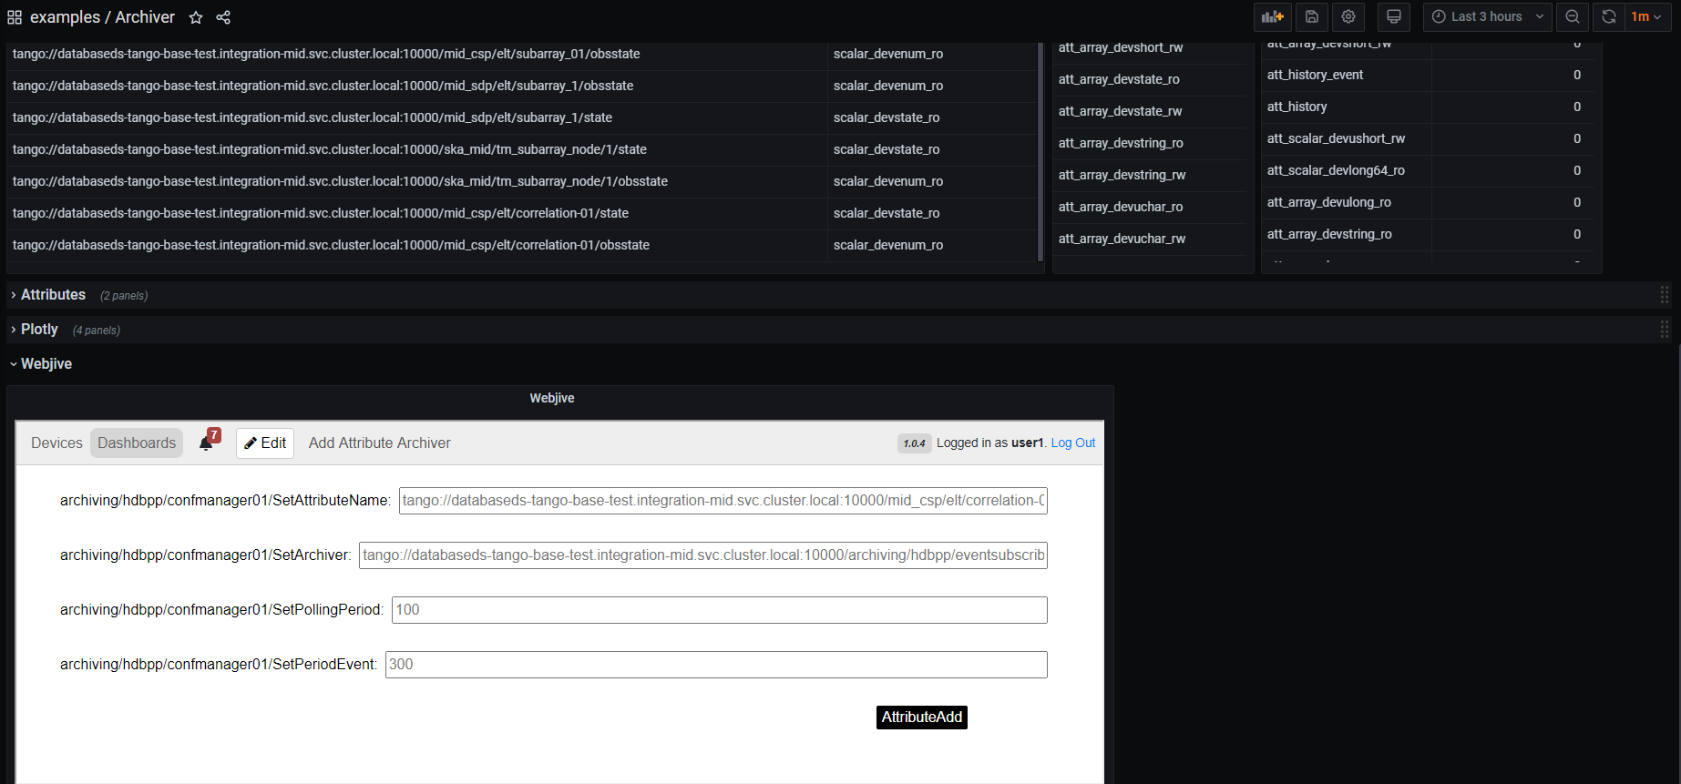
Webjive integration
Include webjive as Grafana Panel
Iframe: not very common but there’s no security risk
Problems(?):
Authentication external to Grafana
To get the webjive dashboard some clicks are needed

Slide 19
Thanks
More information at: gitlab.com/ska-telescope/TANGO-grafana

